Slide 1



Trusted sla-guided data integration on multi-cloud environments
Daniel Aguiar da Silva Carvalho, Magellan, IAE, Université Jean Moulin Lyon3
Advisors
Chirine Ghedira Guegan, LIRIS, UMR5205, IAE, Université Jean Moulin Lyon3, France
Genoveva Vargas-Solar, CNRS, LIG-LAFMIA, France
Nadia Bennani, LIRIS, UMR5205, INSA-Lyon, - France
Notes:
Good morning, my name is Daniel Aguiar and today I will present my thesis work entitled « Trusted SLA-Guided Data Integration on Multi-Cloud Environment » supervised by Chirine Ghedira-Guegan, Genoveva Vargas-Solar and Nadia Bennani.

Slide 2
Daniel Aguiar da Silva Carvalho
Current position
2014-2017
3rd year of PhD
InfoMaths doctoral school, University Lyon 1, Magellan Lab, Lyon3
Projects & Internships
Project Multi-cloud, ARC-6
Education
2013
Master in Systems and Computing
Federal University of Rio Grande do Norte, Brazil
Projects & Internships
4-months Internship
UDELAR, Uruguay (CAPES)
National Research Network, Brazil
2011
XXX degree System analysis
Federal Institute of Rio Grande do Norte, Brazil
Notes:
Briefly presenting myself,
Currently, I am in the third year of PhD attached to the doctoral school InfoMaths at Lyon1 and working in the Magellan research center at Lyon3. My thesis is funded by the ARC 6 project.
In 2013, I concluded my master in systems and computing at the federal university of rio grande do norte, Brazil. During this time I had a CAPES scholarship and I made a 4-months interniship at UDELAR, Uruguay. Furthermore, I have worked to in a project funded by the National Research Network in Brazil.
In 2011, I graduted in systems analysis in Federal Institute of Rio Grande do Norte, Brazil.

Slide 3
Research context: data integration
Query
Result
Data integration: the teenage years. Halevy, A., Rajaraman, A., & Ordille, J. (VLDB 2006, September)
Schema integration: Past, present, and future (Ram, S., & Ramesh, V. 1999)
Global schema
Mediator
Query rewriting
Data integration architectures:
Multi-databases, federations, DW, …
(Domenig & Dittrich 1999 Sigmod Record)
MiniCon algorithm for query rewriting (Pottinger and Halevy, 2001)
Exported schemata
Data
source A
Data
source B
Data
source C
Heterogeneous data sources known in advance
Notes:
The research context of this thesis is data integration. The very classic vision of data integration is defined as follows: Given a set of heterogeneous data sources known in advance, provide solutions for retrieving data and answering queries.
This problem is well known in the database domain. Several works have been proposed concerning, for example, data models equivalence and transformation, schema matching and integration, and query rewriting algorithm such as MiniCon.

Slide 4
Research context: data integration
Services lookup and matching
[1] Paolucci, M., Kawamura, T., Payne, T. R., & Sycara, K. (2002, June). Semantic matching of web services capabilities. In International Semantic Web Conference (pp. 333-347). Springer Berlin Heidelberg.
[2} Bramantoro, A., Krishnaswamy, S., & Indrawan, M. (2005, November). A semantic distance measure for matching web services. In International Conference on Web Information Systems Engineering (pp. 217-226). Springer Berlin Heidelberg.
[3} APA Maximilien, E. M., & Singh, M. P. (2004, November). Toward autonomic web services trust and selection. In Proceedings of the 2nd international conference on Service oriented computing (pp. 212-221). ACM.
Query
Result
Mediator
Query rewriting techniques adapted to service composition
Exported API
[4] Barhamgi, M., Benslimane, D., and Medjahed, B. (2010). A query rewriting approach for web service composition. IEEE T. Services Computing, 3(3):206–222.
[5] da Costa, U. S., Alves, M. H. F., Musicante, M. A., and Robert, S. (2013). Automatic refinement of service compositions. In Daniel, F., Dolog, P., and Li, Q., editors, ICWE, volume 7977 of Lecture Notes in Computer Science, pages 400–407. Springer.
[6] Zhao, W., Liu, C., and Chen, J. (2011). Automatic composition of information-providing web services based on query rewriting. Science China Information Sciences, pages 1–17.
. . .
Distributed data services
Notes:
The emergence of data services changed the data integration problem. Particularly, the hypothesis that assumed that data sources were known in advance.
The data integration problem in the presence of services as data providers redefined the problem as follows: Given a query expressing data requirements, look up data services that can fulfill those requirements. The assumptions were that services exported their API and that they can export data under a pivot model that can be used for integrating results.
Thus, the query rewriting problem was redefined as a matching and a service composition problem and has led to fruitful results on query rewriting and service matching.

Slide 5
Open issues
Data consumers express queries but they do not express requirements: data quality & conditions in which data is consumed
Preferences
DataProducer
DataConsumer
- privacy: String
- trust: String
- veracity: String
freshness: String
provenance: String
awareness: String
type: String
- accessConstraints: String
- productionRate: String
- productionTime: Date
- location: String
API
x
- Do not export the properties of the data they deliver
- Do not export the conditions in which they deliver data
Schema
DataQoS
- privacy: String
- trust: String
- veracity: String
freshness: String
provenance: String
awareness: String
type: String
Data
source A
produces
consumes
Notes:
This context has some open issues such as: click
Data producers export an API to access and consume their data click
but they do not export the properties of the data they deliver and the conditions in which they deliver data click
Data consumers consumes data according to their requirements click
But the queries they define do not express data quality requirements and conditions in which data is consumed

Slide 6
Open issues
CloudInfrastructure
Cloud services are delivered to consumers according to properties
Cloud subscriptions determine the conditions in which data services can be accessed
- accessPolicies: String
- processingCapacity: Integer
- memoryLimit: Integer
storageLimit: Integer
requestsDay: Integer
dataTransferedDay: String
subscribe
subscribe
deploy
Data consumers subscribe to cloud providers to consume services according to business models
Data integration done by IaaS services of clouds depending on subscription conditions
MultiCloud
DataProducer
Preferences
DataConsumer
- privacy: String
- trust: String
- veracity: String
freshness: String
provenance: String
awareness: String
type String
- accessConstraints: String
- productionRate: String
- productionTime: Date
- location: String
Data
- privacy: String
- trust: String
- veracity: String
freshness: String
provenance: String
awareness: String
type: String
- Dara producers deployment is not transparent to the data integration process
- Data producers are services guided by service level agreement contracts
produces
consumes
Notes:
The multi-cloud includes a set of cloud infrastructures and data consumers subscribe to this infrastructures. Click
These subscriptions determine the conditions in which data services can be accessed. Data consumers subscribe to cloud providers to consume services according to business models and the integration is done by services depending to the subscription conditions click
Data producers provide data which is consumed by data consumers click
And also subscribe to clouds to deploy their services click
However, the deployment is not transparent to data integration process and data producers are guided to SLA contracts which means that they can be out of resources

Slide 7
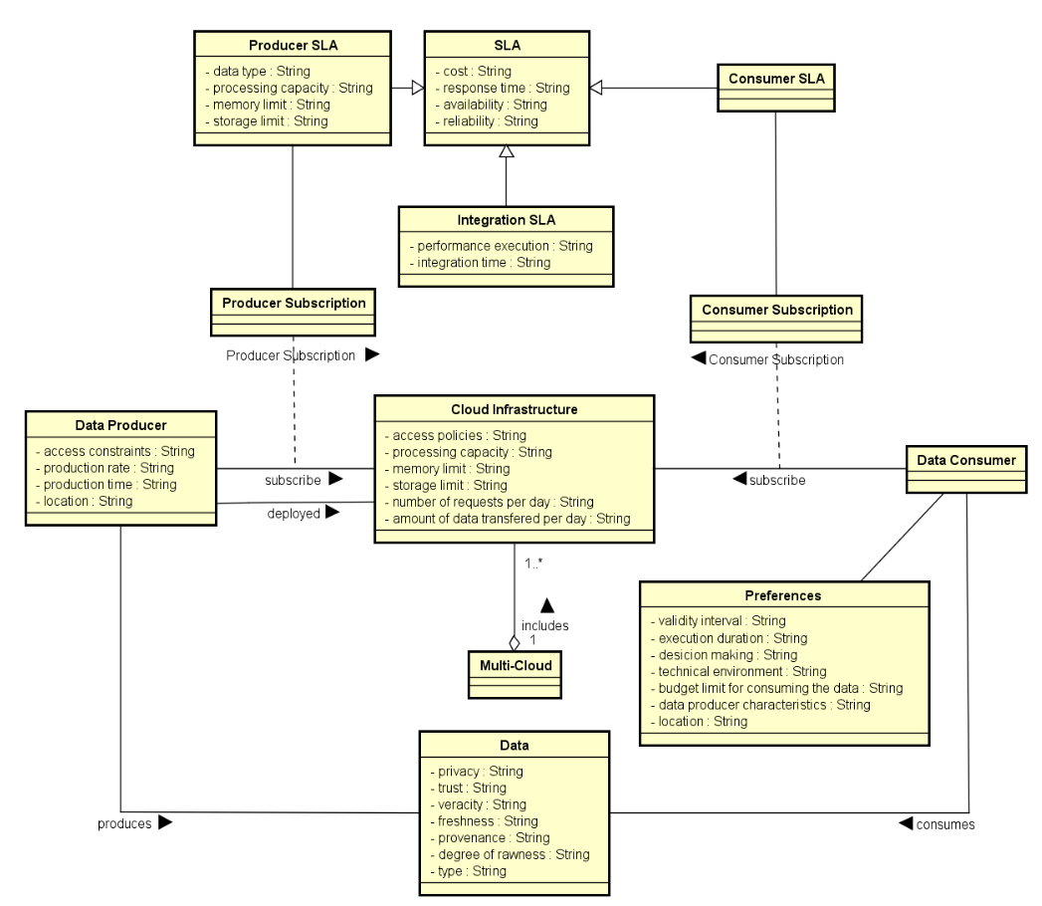


Open issues
SLA
Schema
API
SLA
SLA
Data
source A
Query requirements associated to performance (availability and response time) and privacy
Services selection and composition are not done considering SLAs
Data providers can be out of resources according to their cloud subscriptions
Current SLAs are only include performance and business rules
Notes:
Click In this scenario, data consumer define queries click
Currently, without taking into account the SLAs he has with clouds click
And his requirements are only associated to performance and privacy issues click 2x
The service selection and composition do not take into consideration SLAs click
Once data providers are guided by SLA they can be out of resources click 2x
Current SLAs mainly include performance aspects and business rules

Slide 8
SLA Guided data integration meta model
First contribution of my work
Deduced through a Systematic Mapping Methodology
¹ D. A. S. Carvalho, P. A. S. Neto, C. Ghedira, G. Vargas-Solar, N. Bennani. Towards Quality Guided Data Integration on Multi-Cloud Settings. 14th international conference on service oriented computing (ICSOC), Oct 2016, Banff, Alberta, Canada.
Notes:
Based on these open issues, deduced from a SM methodology we have proposed a SLA guided data integration meta model. This first contribution resulted in a paper published on DEXA 2015.

Slide 9



Data integration from data services
SLA
SLA
Availabity > 99,9%
Price per call = 0,5$
SLA
Data provider A: infected patient
Data provider C: Personal information
Availabity > 97%
Price per call = 0,1$
Availabity > 98%
Price per call = 0,3$
Data provider B: DNA information
Notes:
Consider the following example consisting of services that provide biological data to Health professionals
… data provider A provides information about infected patients
… data provider B provides DNA information
… data provider C provides personal information
Besides each provider exports its own Service Level Agreement specifying what a consumer can expect from its service…
In this example SLA’s define the availability and the price per call for each service. Thus data provider A is available 97% of the time and the price per call costs 0,15
Whereas data provider C is 99,9% of the time available and the price per call is 0,5 cents

Slide 10
Data integration from data services
SLA
SLA
Availabity > 99,9%
Price per call = 0,5$
Retrieve personal and DNA information from patients that were infected by flu, using services with
availability higher than 98%, price per call less than 0.2$ & total cost less than 5$
SLA
Q(dis?; dna!, info!) :=
A1 (dis?; p!), A2 (p?; dna!), A3 (p?; info!),
dis= “flu” , [availability > 99%, price per call < 0,2$, total cost < 5$]
Data provider A: infected patient
Data provider C: Personal information
Availabity > 97%
Price per call = 0,1$
Availabity > 98%
Price per call = 0,3$
Data provider B: DNA information
Notes:
To better understand our context, consider the following example consisting of services that provide biological data to Health professionals. There are three data provider: click
Data provider A provides information about infected patients click … data provider B provides DNA information click … data provider C provides personal information click
Besides each provider exports its own Service Level Agreement specifying what a consumer can expect from its service…
In this example SLA’s define the availability and the price per call for each service. Thus data provider A is available 97% of the time and the price per call costs 0,15 Whereas data provider C is 99,9% of the time available and the price per call is 0,5 cents click
This query can be formally defined as follows click

Slide 11
Data integration from data services
SLA
SLA
Availabity > 99,9%
Price per call = 0,5$
S1 (a?; b!) := A1 (a?; b!) [availability > 98%, price per call = 0,2$]
S2 (a?; b!) := A1 (a?; b!) [availability > 98%, price per call = 0,1$]
S3 (a?; b!) := A2 (a?; b!) [availability > 99%, price per call = 0,1$]
S4 (a?; b!) := A1 (a?; p!), A2 (p?; b!) [availability > 98%, price per call = 0,1$]
S5 (a?; b!) := A3 (a?; b!) [availability > 98%, price per call = 0,0$]
S6 (a?; b!, c!) := A1 (a?; p!), A2 (p?; b!), A3 (p?; c!) [availability > 99%, price per call = 0,2$]
S7 (a?; b!) := A4 (a?; b!) [availability > 99%, price per call = 0,2$]
SLA
Data provider A: infected patient
Data provider C: Personal information
Availabity > 97%
Price per call = 0,1$
Availabity > 98%
Price per call = 0,3$
Data provider B: DNA information
Notes:
Consider the following example consisting of services that provide biological data to Health professionals
… data provider A provides information about infected patients
… data provider B provides DNA information
… data provider C provides personal information
Besides each provider exports its own Service Level Agreement specifying what a consumer can expect from its service…
In this example SLA’s define the availability and the price per call for each service. Thus data provider A is available 97% of the time and the price per call costs 0,15
Whereas data provider C is 99,9% of the time available and the price per call is 0,5 cents

Slide 12

Data integration from data services
SLA
SLA
Availabity > 99,9%
Price per call = 0,5$
Q(dis?; dna!, info!) :=
A1 (dis?; p!), A2 (p?; dna!), A3 (p?; info!),
dis= “flu” , [availability > 99%, price per call < 0,2$, total cost < 5$]
SLA
Data provider A: infected patient
Data provider C: Personal information
Availabity > 97%
Price per call = 0,1$
Availabity > 98%
Price per call = 0,3$
Data provider B: DNA information
Notes:
Consider the following example consisting of services that provide biological data to Health professionals
… data provider A provides information about infected patients
… data provider B provides DNA information
… data provider C provides personal information
Besides each provider exports its own Service Level Agreement specifying what a consumer can expect from its service…
In this example SLA’s define the availability and the price per call for each service. Thus data provider A is available 97% of the time and the price per call costs 0,15
Whereas data provider C is 99,9% of the time available and the price per call is 0,5 cents

Slide 13
Composing services for answering queries
Q(dis?; dna!, info!) := A1 (dis?; p!), A2 (p?; dna!), A3 (p?; info!), d= “flu, [ availability > 99%, price per call < 0,2$, total cost < 5$]
S1, S3, S5
S2, S3, S5
S4, S5
S6
Data provider A: infected patient
Data provider C: Personal information
S1 (a?; b!) := A1 (a?; b!) [availability > 98%,
price per call = 0,2$]
S2 (a?; b!) := A1 (a?; b!) [availability > 98%,
price per call = 0,1$]
S5 (a?; b!) := A3 (a?; b!) [availability > 98%,
price per call = 0,0$]
S6 (a?; b!, c!) := A1 (a?; p!), A2 (p?; b!), A3 (p?; c!) [availability > 99%,
price per call = 0,2$]
S7 (a?; b!) := A4 (a?; b!) [availability > 99%,
price per call = 0,2$]
Data provider B: DNA information
S3 (a?; b!) := A2 (a?; b!) [availability > 99%, price per call = 0,1$]
S4 (a?; b!) := A1 (a?; p!), A2 (p?; b!) [availability > 98%, price per call = 0,1$]
Notes:
In the same way the queries, click data services can also be defined, for example: click considering the data provider we mentioned before click the following DS could be defined. Where ...
Given the query, the different concrete services can be combined in order to produce results. Such as composing:
...S1 (which retrieves infected patients), S3 (which retrieves DNA) and S5 (which retrieves personal information)
...S2 (which retrieves infected patients), S3 (which retrieves DNA) and S5 (which retrieves personal information)
...S4 (which retrieves infected patients and DNA) and S5 (which retrieves personal information) or
...S6 (which returns all desired data)
Here, it is interesting to highlight that a filtering process is necessary to guarantee that the user preferences and requirements are satisfied.

Slide 14
Vision: Data integration
A combinatorial problem where a query result is a data collection integrated by
composing different data providers
data processing (cloud) services
that fulfill quality constraints and SLAs specified by a data consumer
Notes:
Considering this context, in our vision, data integration deals with a combinatorial problem where a query result is a data collection integrated by composing different data providers and data processing (cloud) services that fulfill quality constraints and SLAs specified by a data consumer.

Slide 15
Objective
Guide the integration process explicitly considering
data providers quality &
infrastructure properties
(reliability, computing, storage & memory capacity, cost)
Notes:
In consequence, our objective is to guide the integration process explicitly considering data providers quality and infrastructure properties such as reliability, computing, storage and memory capacity, and cost.

Slide 16
Approach: data integration workflow
Reusing previous
results
Search for previous queries
With respect to our query taxonomy and reusability approach
Storing results
- With respect to quality requirements
- According to our query taxonomy
Processing the complete rewriting
Storing results in our query history
Service-based query rewriting according to SLA
Notes:
To achieve our objectives we have proposed a data integration approach which concerns the following workflow:
First, we search for previous queries in our history. The queries are matched with respect to the quality requirements and similar queries are identified in accordance with our query taxonomy.
Then, if a match is found, we can reuse the results (data services and compositions) according to the type of query and the reusable aspects associated to this type.
If no match is found, the entire rewriting process is done according to the user requirements and SLAs.
And, finally, the results for this new query is stored to possibly be reused in a next query.

Slide 17
Results and contribution
Data Integration Metamodel
Building the corpus of State of the Art using the systematic mapping methodology¹
Describing the challenges and problems of SLA guided data integration
Rhone Query
Rewriting Algorithm
Rewriting approach taking into consideration user requirements and Service Level Agreements
Query Taxonomy
Indentification and formalization of queries to be treated by our approach
Query Rewriting Reuse Strategies
Formalization of a reusability approach for reducing the query rewriting overhead
¹ D. A. S. Carvalho, P. A. Souza Neto, G. Vargas-Solar, N. Bennani, C. Ghedira, Can Data Integration Quality be Enhanced on Multi-cloud using SLA?, In 26th Int. Conf. on Database and Expert Systems Applications, Spain, 2015.
Notes:
The results and contribution achieved while developing our approach are sumarized following:
First, we have designed a data integration metamodel adapted to the multi-cloud context. This model describes the challenges and problems associated to the SLA guided data integration, and it was done based on our corpus of state of the art that was built using a systematic mapping methodology. As result this methodology work, we had a paper published in DEXA 2015.
We have designed and implemented a query rewriting algorithm which takes into consideration user requirements and SLAs called Rhone.
A set of queries that can be treated by our approach were formalized,
and based on them we have formalized a reusability approach for reducing the overhead of query rewriting process

Slide 18
Rhone Service-Based Query Rhone: Rewriting Algorithm
Selecting candidate concrete services
Creating candidate service descriptions (CSD)
Combinig CSDs
Producing rewritings
A rewriting algorithm customizing
data providers (services) look up
data integration considering different data consumers requirements and expectations
requirements & expectations depend on the context in which they consume data (e.g., mobile devices with few physical capacities, critical decision making)
¹ D. A. S. Carvalho, P. A. S. Neto, C. Ghedira, G. Vargas-Solar, N. Bennani. Rhone: a quality-based query rewriting algorithm for data integration. East-European Conference on Advances in Databases and Information Systems, Aug 2016, Prague, France. ADBIS East-European Conference on Advances in Databases and Information Systems, 2016.
Notes:
We have proposed and designed a service-based query rewriting algorithm taking into account our approach and hypotesis.
It consists in 4 steps: including service matching and service combination ensuring that they fulfill quality requirements.
Our algorithm customizes:
The data providers services look up. The data integration considering different data consumers requirements and expectations
And the requirements and expectations depend on the context in which they consume data (e.g., mobile devices with few physical capacities, critical decision making)
In the following I briefly describe the general principle of the steps.

Slide 19
Concrete service matching
S1 (a?; b!) := A1 (a?; b!) [availability > 98%, price per call = 0,2$]
A query with preferences
A set of concrete services &
Choose those services that match data required with data produced
S2 (a?; b!) := A1 (a?; b!) [availability > 98%, price per call = 0,1$]
S3 (a?; b!) := A2 (a?; b!) [availability > 99%, price per call = 0,1$]
S4 (a?; b!) := A1 (a?; p!), A2 (p?; b!) [availability > 98%, price per call = 0,1$]
S5 (a?; b!) := A3 (a?; b!) [availability > 98%, price per call = 0,0$]
S6 (a?; b!, c!) := A1 (a?; p!), A2 (p?; b!), A3 (p?; c!) [availability > 99%, price per call = 0,2$]
S7 (a?; b!) := A4 (a?; b!) [availability > 99%, price per call = 0,2$]
Q(dis?; dna!, info!) :=
A1 (dis?; p!), A2 (p?; dna!), A3 (p?; info!),
d= “flu”, [ availability > 98%, price per call < 0,2$, total cost < 5$]
Notes:
While selecting candidate concrete services we deal with a concrete service matching.
For instance, in this step considering a query with preferences and a set of concrete services.
We have to choose those services that match data required with data produced.
Click
As you can see we select services that can produce a result for the user query.
And, consequently, the service S7 is discarded once it can not produce a result to the query.
Click

Slide 20
Matching quality features
A query with preferences
A set of concrete services that match data required with data produced
Choose services that match preferences
S1 (a?; b!) := A1 (a?; b!) [availability > 98%, price per call = 0,2$]
S2 (a?; b!) := A1 (a?; b!) [availability > 98%, price per call = 0,1$]
S3 (a?; b!) := A2 (a?; b!) [availability > 99%, price per call = 0,1$]
S4 (a?; b!) := A1 (a?; p!), A2 (p?; b!) [availability > 98%, price per call = 0,1$]
S5 (a?; b!) := A3 (a?; b!) [availability > 98%, price per call = 0,0$]
S6 (a?; b!, c!) := A1 (a?; p!), A2 (p?; b!), A3 (p?; c!) [availability > 99%, price per call = 0,2$]
S7 (a?; b!) := A4 (a?; b!) [availability > 99%, price per call = 0,2$]
Q(dis?; dna!, info!) :=
A1 (dis?; p!), A2 (p?; dna!), A3 (p?; info!),
d= “flu”, [ availability > 98%, price per call < 0,2$, total cost < 5$]
Notes:
we also deal with a matching of quality features according to the user preferences and requirements
In our example the quality feature “Price per call” guaranteed by the services S1 and S6 do not cover the user requirement. Thus, they are discarded.
Once this process is finished we have a final list of candidate concrete services.

Slide 21
Matching & combining concrete services
CSD₂
Combinations
S2 (a?; b!) := A1 (a?; b!) [availability > 98%, price per call = 0,1$]
p₁ = { CSD₂ }
p₂ = { CSD₂ , CSD₃ }
p₃ = { CSD₂ , CSD₃ , CSD₅ }
CSD₃
S3 (a?; b!) := A2 (a?; b!) [availability > 99%, price per call = 0,1$]
S4 (a?; b!) := A1 (a?; p!), A2 (p?; b!) [availability > 98%, price per call = 0,1$]
CSD₅
S5 (a?; b!) := A3 (a?; b!) [availability > 98%, price per call = 0,0$]
Q(dis?; dna!, info!) :=
A1 (dis?; p!), A2 (p?; dna!), A3 (p?; info!),
dis= “flu”, [ availability > 98%,
price per call < 0,2$,
total cost < 5$]
21
Notes:
Considering our candidate concrete services, CSDs for S2, S3 and S5 are created.
A CSD for S4 cannot be created once the variables mapping is not possible.
Click
Given these 3 CSDs the combinations are produced taking into account the part of the query that it covers. In this case, 3 combiantions are generated.

Slide 22
Validating combinations
CSD₂
Combinations
S2 (a?; b!) := A1 (a?; b!) [availability > 98%, price per call = 0,1$]
p₁ = { CSD₂ }
p₂ = { CSD₂ , CSD₃ }
p₃ = { CSD₂ , CSD₃ , CSD₅ }
CSD₃
S3 (a?; b!) := A2 (a?; b!) [availability > 99%, price per call = 0,1$]
S4 (a?; b!) := A1 (a?; p!), A2 (p?; b!) [availability > 98%, price per call = 0,1$]
CSD₅
S5 (a?; b!) := A3 (a?; b!) [availability > 98%, price per call = 0,0$]
Q(dis?; dna!, info!) :=
A1 (dis?; p!), A2 (p?; dna!), A3 (p?; info!),
dis= “flu”, [ availability > 98%,
price per call < 0,2$,
total cost < 5$]
22
Notes:
Looking to the combination produced. We have to verify if they cover the entire query and exactly what the user expects.
Click
In this sense, only p3 is a valid rewrite of the query. Why?

Slide 23
Reducing overhead by reusing qR
Q₁(dis?; dna!, info!) := A₁ (dis?; p!), A₂ (p?; dna!), A₃ (p?; info!),
[availability > 99%, price per call < 0,2$, total cost < 5$]
Index
Q₂ := < s?, t?, A, R, C?, w? >
Q₁ := < s, t, A, R, C, w >
Q₃ := < s, t, A, R, C, w >
Q₂ is a subset of Q₁ iff:
Q₂.A ⊂ Q₁.A and Q₂.R ⊲ Q₁.R
look-up(Q₂)
Q₄ := < s, t, A, R, C, w >
Q₂.C ⟵ {c_{i}} st. {⩝c_{i} ∊ Q₁.C, ∄ds ∊ c_{i} | ds is offline}
...
Q₂.C ⟵ project(Q₂)
Q₂ := < s, t, A, R, C, w >
Q₂.S ⟵ {ds_{i}} st. {⩝ds_{i} ∊ Q₁.S, ∃c ∊ Q₂.C | ds_{i} ∊ c}
Q₂.w ⟵ max (Q₂.C)
Define Query similarity based
on concrete services: data providers,
required data types
local and global properties
Query rewriting history: Efficient query lookup with index and look up strategy
Notes:
The process of producing combinations and rewritings is really expensive. Thus, in order to reduce the query overhead we proposed an app

Slide 24
Experimental validation
The Rhone first version is implemented in Java
Evaluate the algorithm’s behavior
performance, quality and cost
Local environment simulating a mono-cloud
including a registry of 100 services
Two approaches compared
Traditional (without considering preferences and SLA) versus
Preference-guided (i.e., Rhone)
Notes:
We have performed experiments in order to validate our algorithm.
The first version is implemented in Java.
The idea behind the experiments is to evaluate the algorithm’s behavior.
To do so, the experiments were executed in a local environment including a service registry of 100 concrete services.
And we have compared two approaches: a traditional (without considering preferences and SLA) versus a preference-guided.

Slide 25
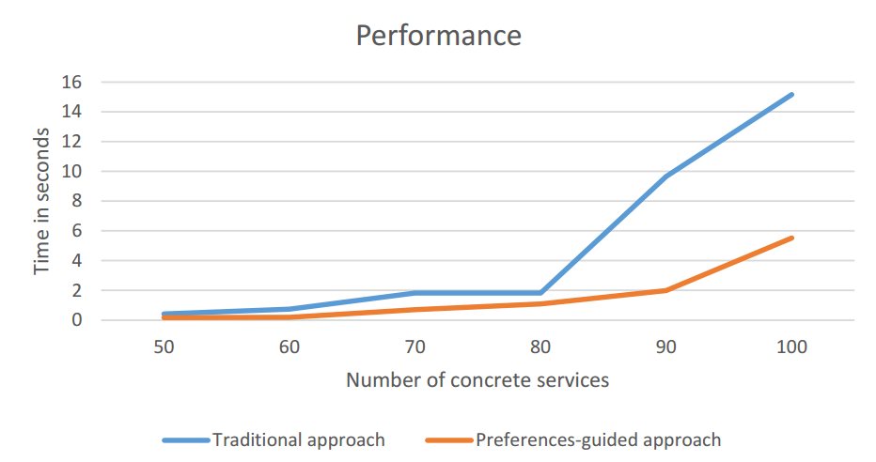
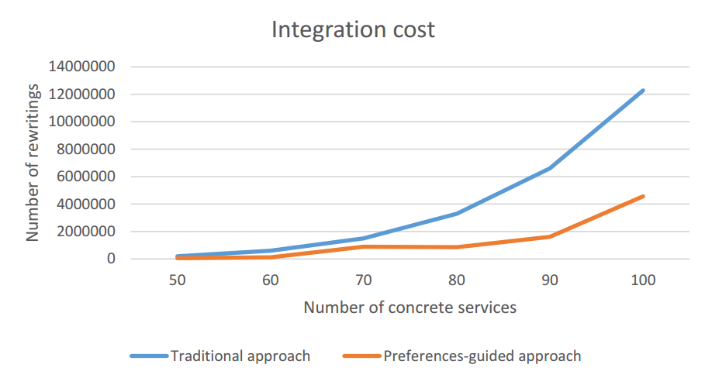
Implementation & experiments
Cloud simulation including 100 services
Expensive while combining services: O(n^{k})
Performance increased reducing the number of rewriting solutions and integration execution time
Integration economic cost potentially reduced
Notes:
Based on the experimental validation, we can show you the Rhones’ profile
We can see the complexity of the different phases. As in the other algorithms, the most expensive step is the combination. It depends on the size of the query and the number of concrete service that could be mapped to the query.
The results of our experimental validation are illustrated by these two charts.
The performance increased by reducing the number of rewriting solutions and integration execution time. As we can see in the chart on the left.
Rewritring solutions quality enhanced and the integration economic cost is reduced once only rewriting that satisfies the user preferences are produced. As we can see in the chart on the right.
Click

Slide 26
Professional and scientific activities
2014.2 | 2015.1 | 2015.2 | 2016.1 | 2016.2 | 2017.1
French course
French course
French course
Courses
Workshop: Writing scientific papers
Magellan IS group
Magellan IS group
Magellan IS group
Presentations
LIRIS SOC team
Presentation ADBIS 2016
Poster ARC
Poster ARC
Thematic schools
Smart cities and Big Data
Publications
DEXA 2015
ADBIS 2016
AICCSA 2015
ICSOC 2016
Continuous work
with advisors
Weekly face to face meetings
Experimentation
Formalization of model & algorithms
Notes:
Now, concerning the professional and scientific activities during the PhD... Click 2X
I have followed three french courses and a workshop for writing scientific papers click
I made internal presentations to the magellan team, click, external presentations in the SOC team, click, I have participated as author and presented our work at adbis 2016, and, click, I have presented posters in the arc 6 scientific journeys
Click moreover I attended to a thematic school on smart cities and big data at Grenoble, and as result to our work we had some publications click dexa… click
Regarding our day-to-day work…

Slide 27
Future work
Activities: | 02/17 | 03/17 | 04/17 | 05/17 | 06/17
Improving and correcting the query taxonomy and reusability approach formalization
Implementing and including in Rhone the reusability functions
Building the proof of concept to the approach
Writing a paper to ER 2017
Concluding the work concerning the heuristic for optimizing service selection and composition
Writing the final thesis document

Slide 28
Daniel Aguiar da Silva Carvalho, Magellan, IAE, Université Jean Moulin Lyon3
Advisors:
Chirine Ghedira Guegan, LIRIS, UMR5205, IAE, Université Jean Moulin Lyon3, France
Genoveva Vargas-Solar, CNRS, LIG-LAFMIA, France
Nadia Bennani, LIRIS, UMR5205, INSA-Lyon, France

